Slide 1
The main event will begin soon. Please take your seat. Access the event program with this QR code =>

Slide 2
Working with the Cyberinet
Matthew A. Bardin - PHD Candidate
Louisana State University - Experimental Music & Digital Media
04/18/2023

Slide 3




Augmented Instrument Practice
What is the Cyberinet?

Slide 4
What is an Augmented Instrument?

Slide 5
Eras of Augmented Instruments
Early
Mid-20th Century
Modern
Completely acoustic.
Generally looking to improve an instrument or crate a new one
Mainly acoustic, more electronic as electronics and computers are invented and improved.
Generally exploring new timbres
Generally, include electronic capabilities, especially as technology continually improves.
Exploring new timbres and instrument functionality.

Slide 6

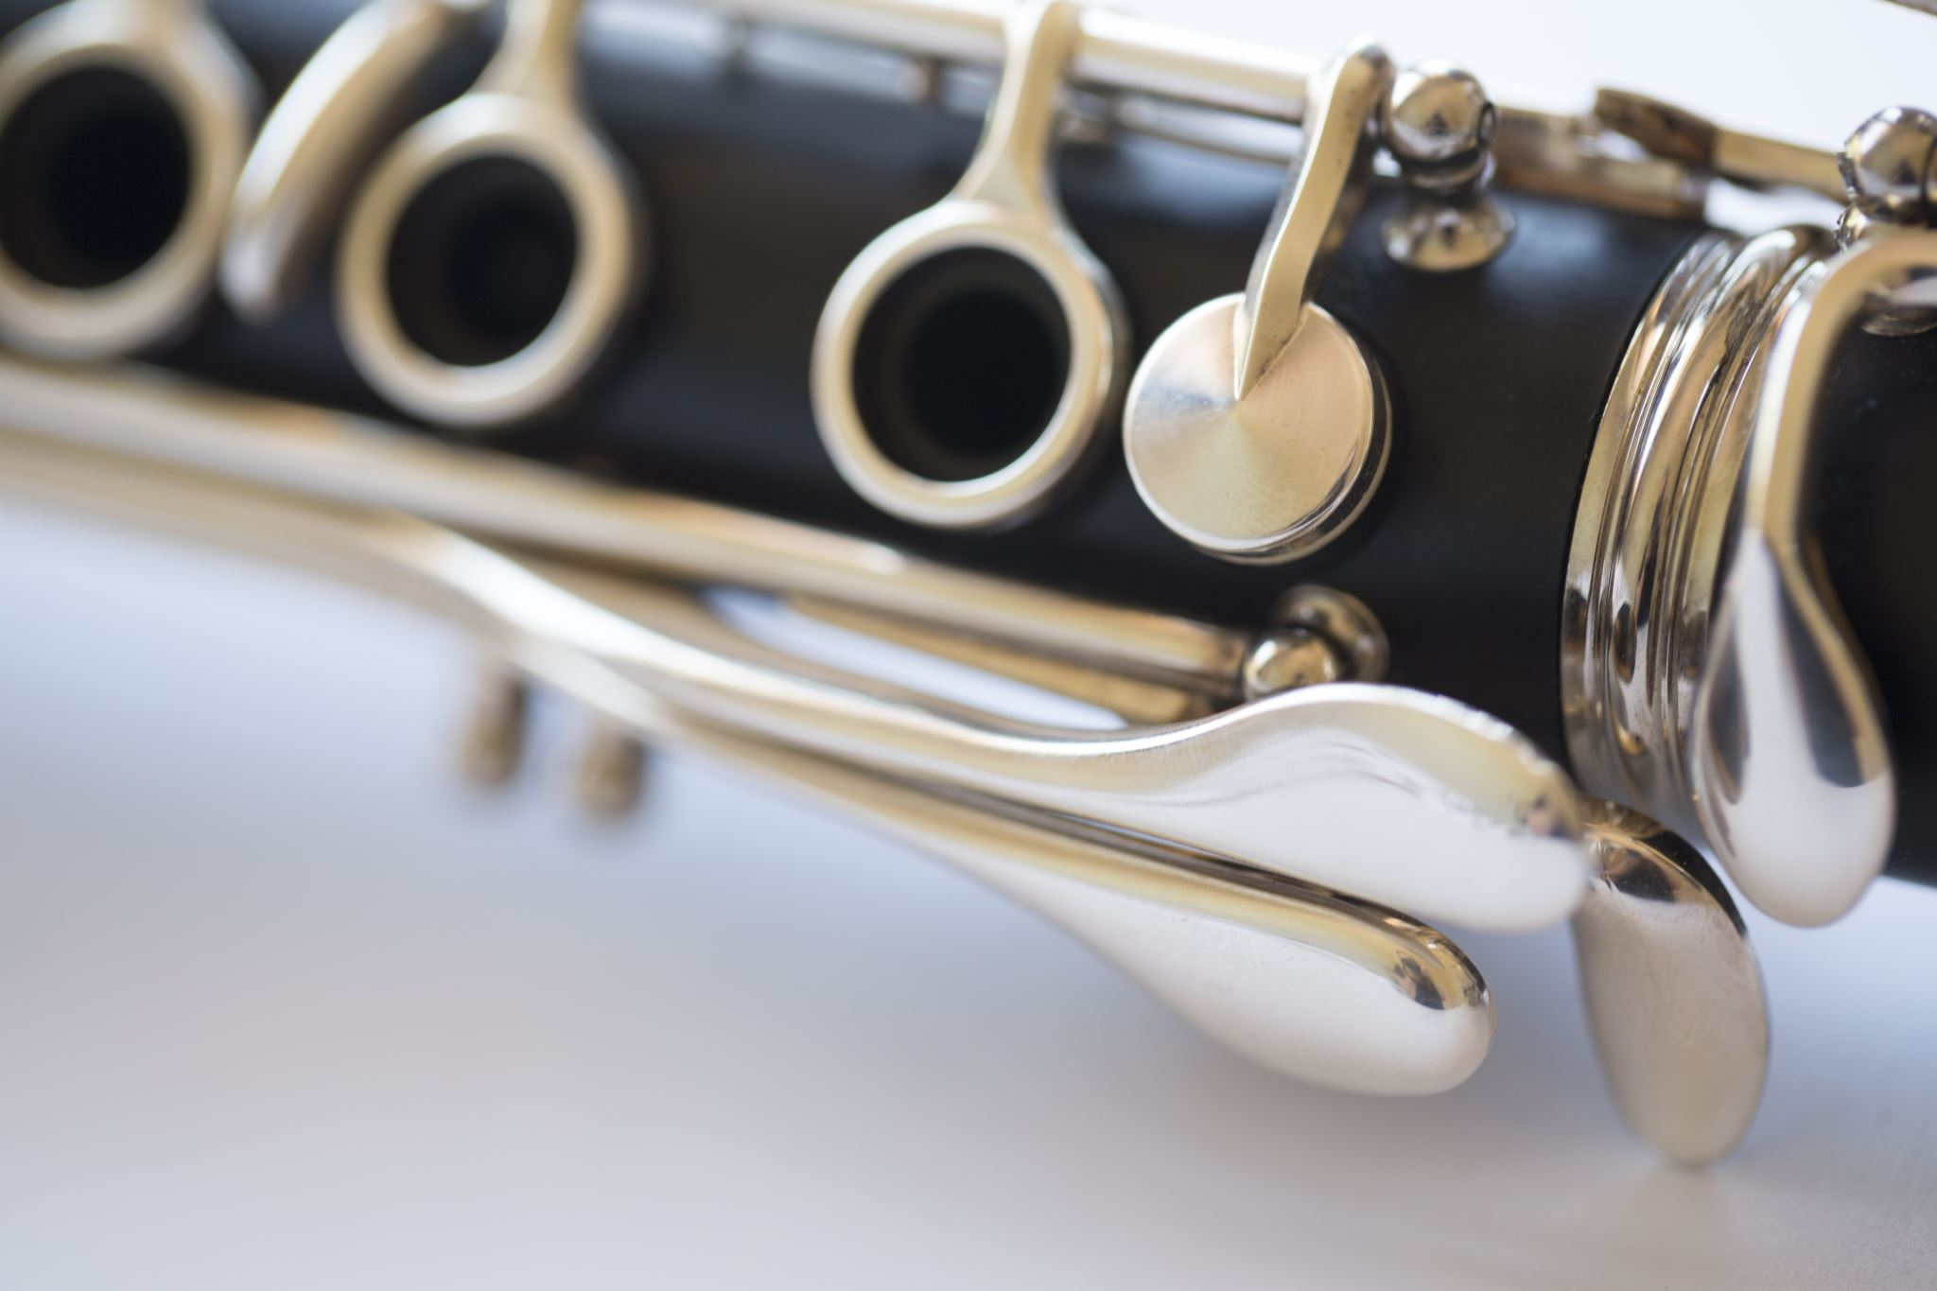
Cybernetic + Clarinet

Slide 7
Why use this Instrument?
The Cyberinet is a sensor array designed to be easily adapted the instrument for electronic music without impeding the performance of the instrument.
The device can be easily added or removed from a standard Bb Clarinet whenever needed.
The Cyberinet can still be used as a regular clarinet barrel while powered off.
Opens near-unlimited sound and control possibilities with minimal additional knowledge.

Slide 8
Why use this Instrument?
The main goal of the Cyberinet is to be user-friendly in every possible state.
Components are all common-place and use standard pin spacings.
Software tools provide easy programming.
Can be used as a compositional AND performance tool.

Slide 9
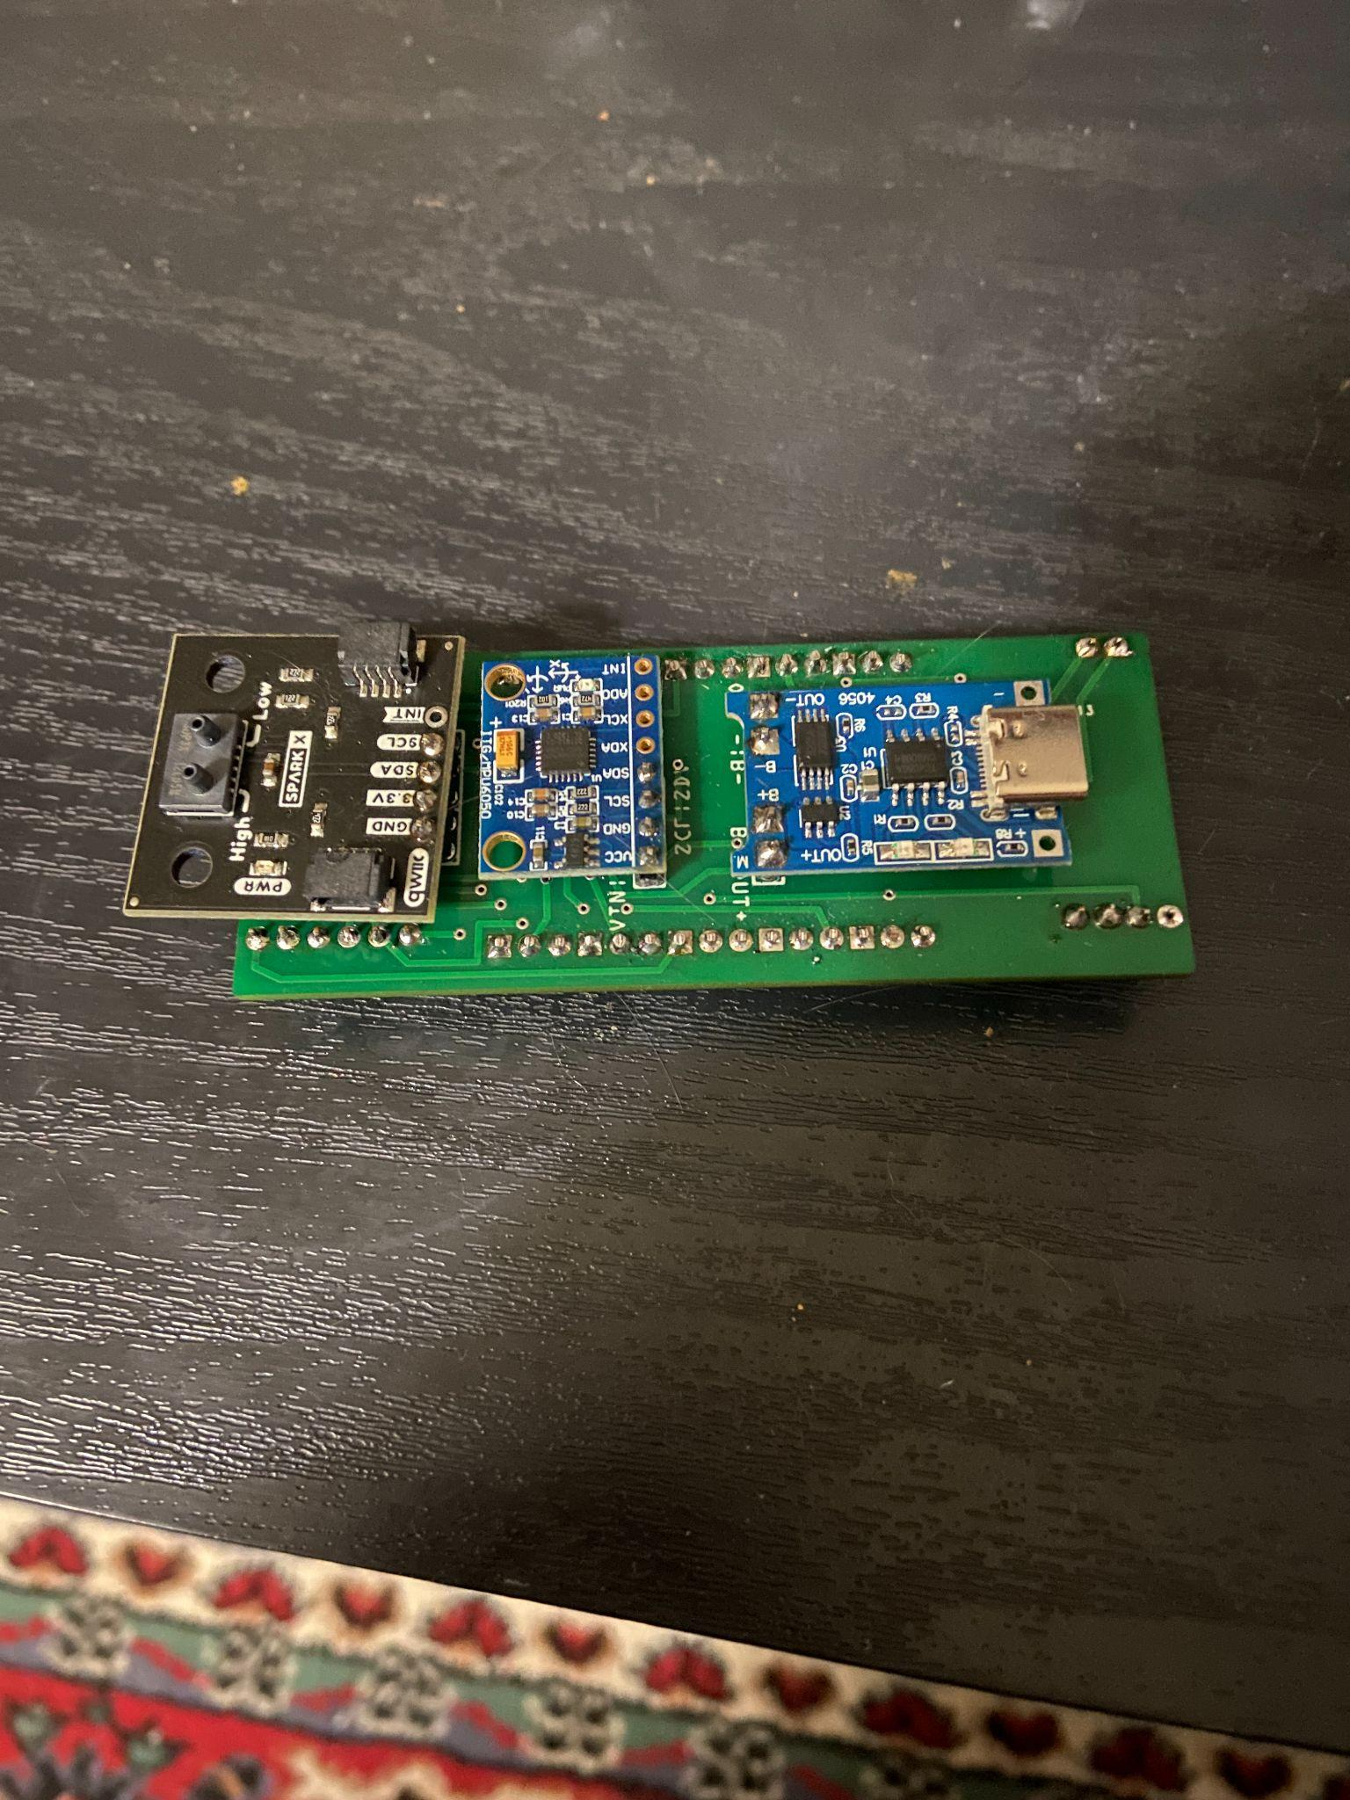
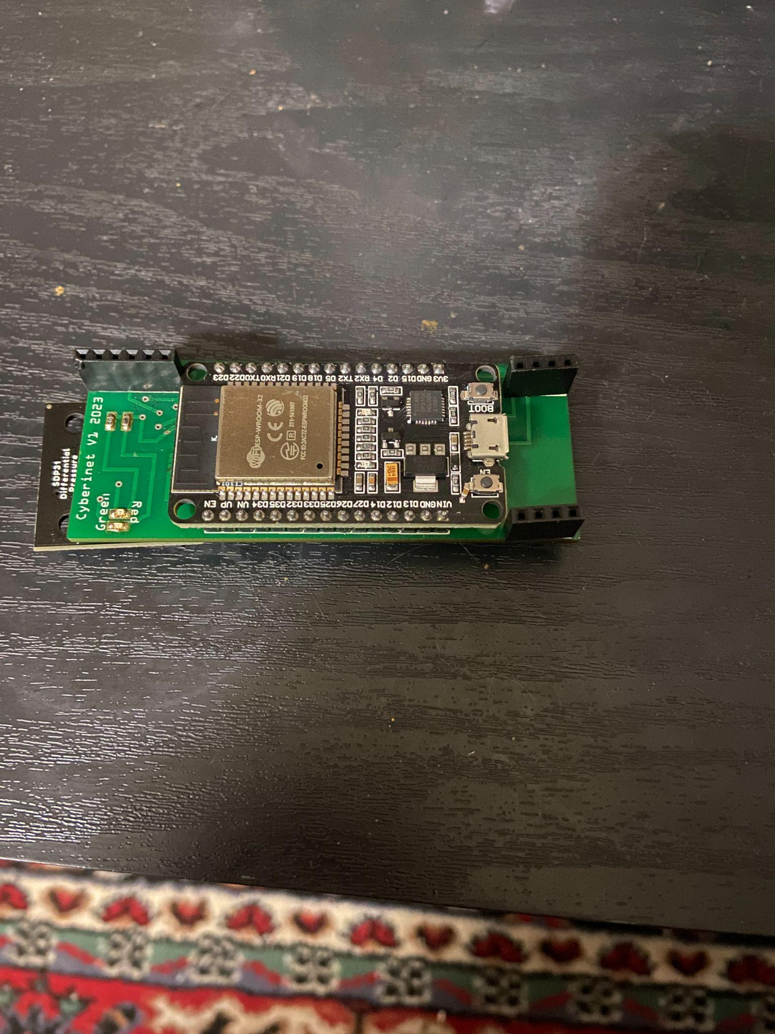
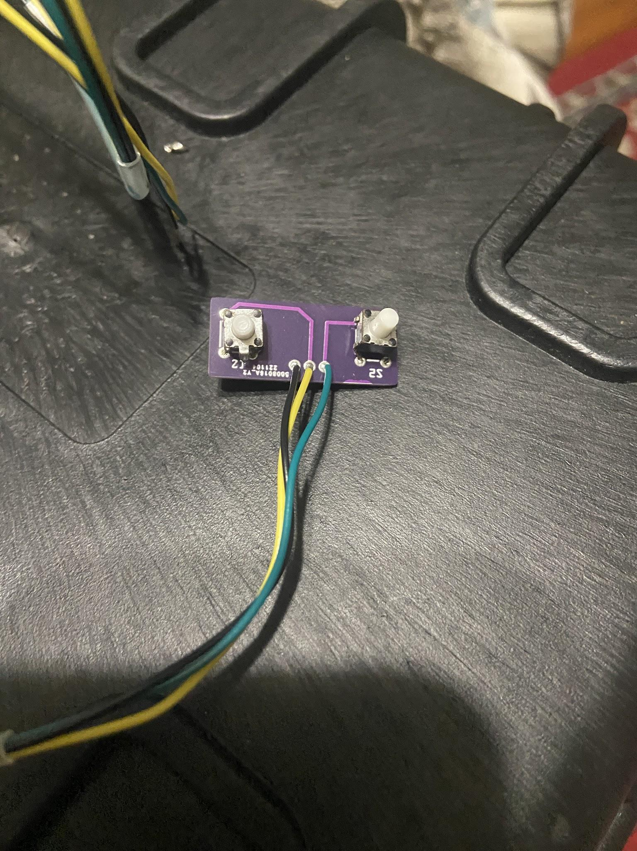
Top
Bottom
Buttons
Main Unit & Button Expansion Prototypes

Slide 10
Components Included
The main Cyberinet is comprised of a main unit and smaller secondary unit.
Main Unit:
Lithium Ion battery to power the device.
TP-4056 board. (controls the charging and power distribution
MPU-6050 board. (6 axis gyroscope and accelerometer)
SDP-31 Qwiic Connect board. (measures air pressure and temperature)
ESP-32 DEVKIT board. (microcontroller and transmitter)
2 programmable LEDs.
Secondary Unit:
2 momentary switches with independently programmable LEDs

Slide 11
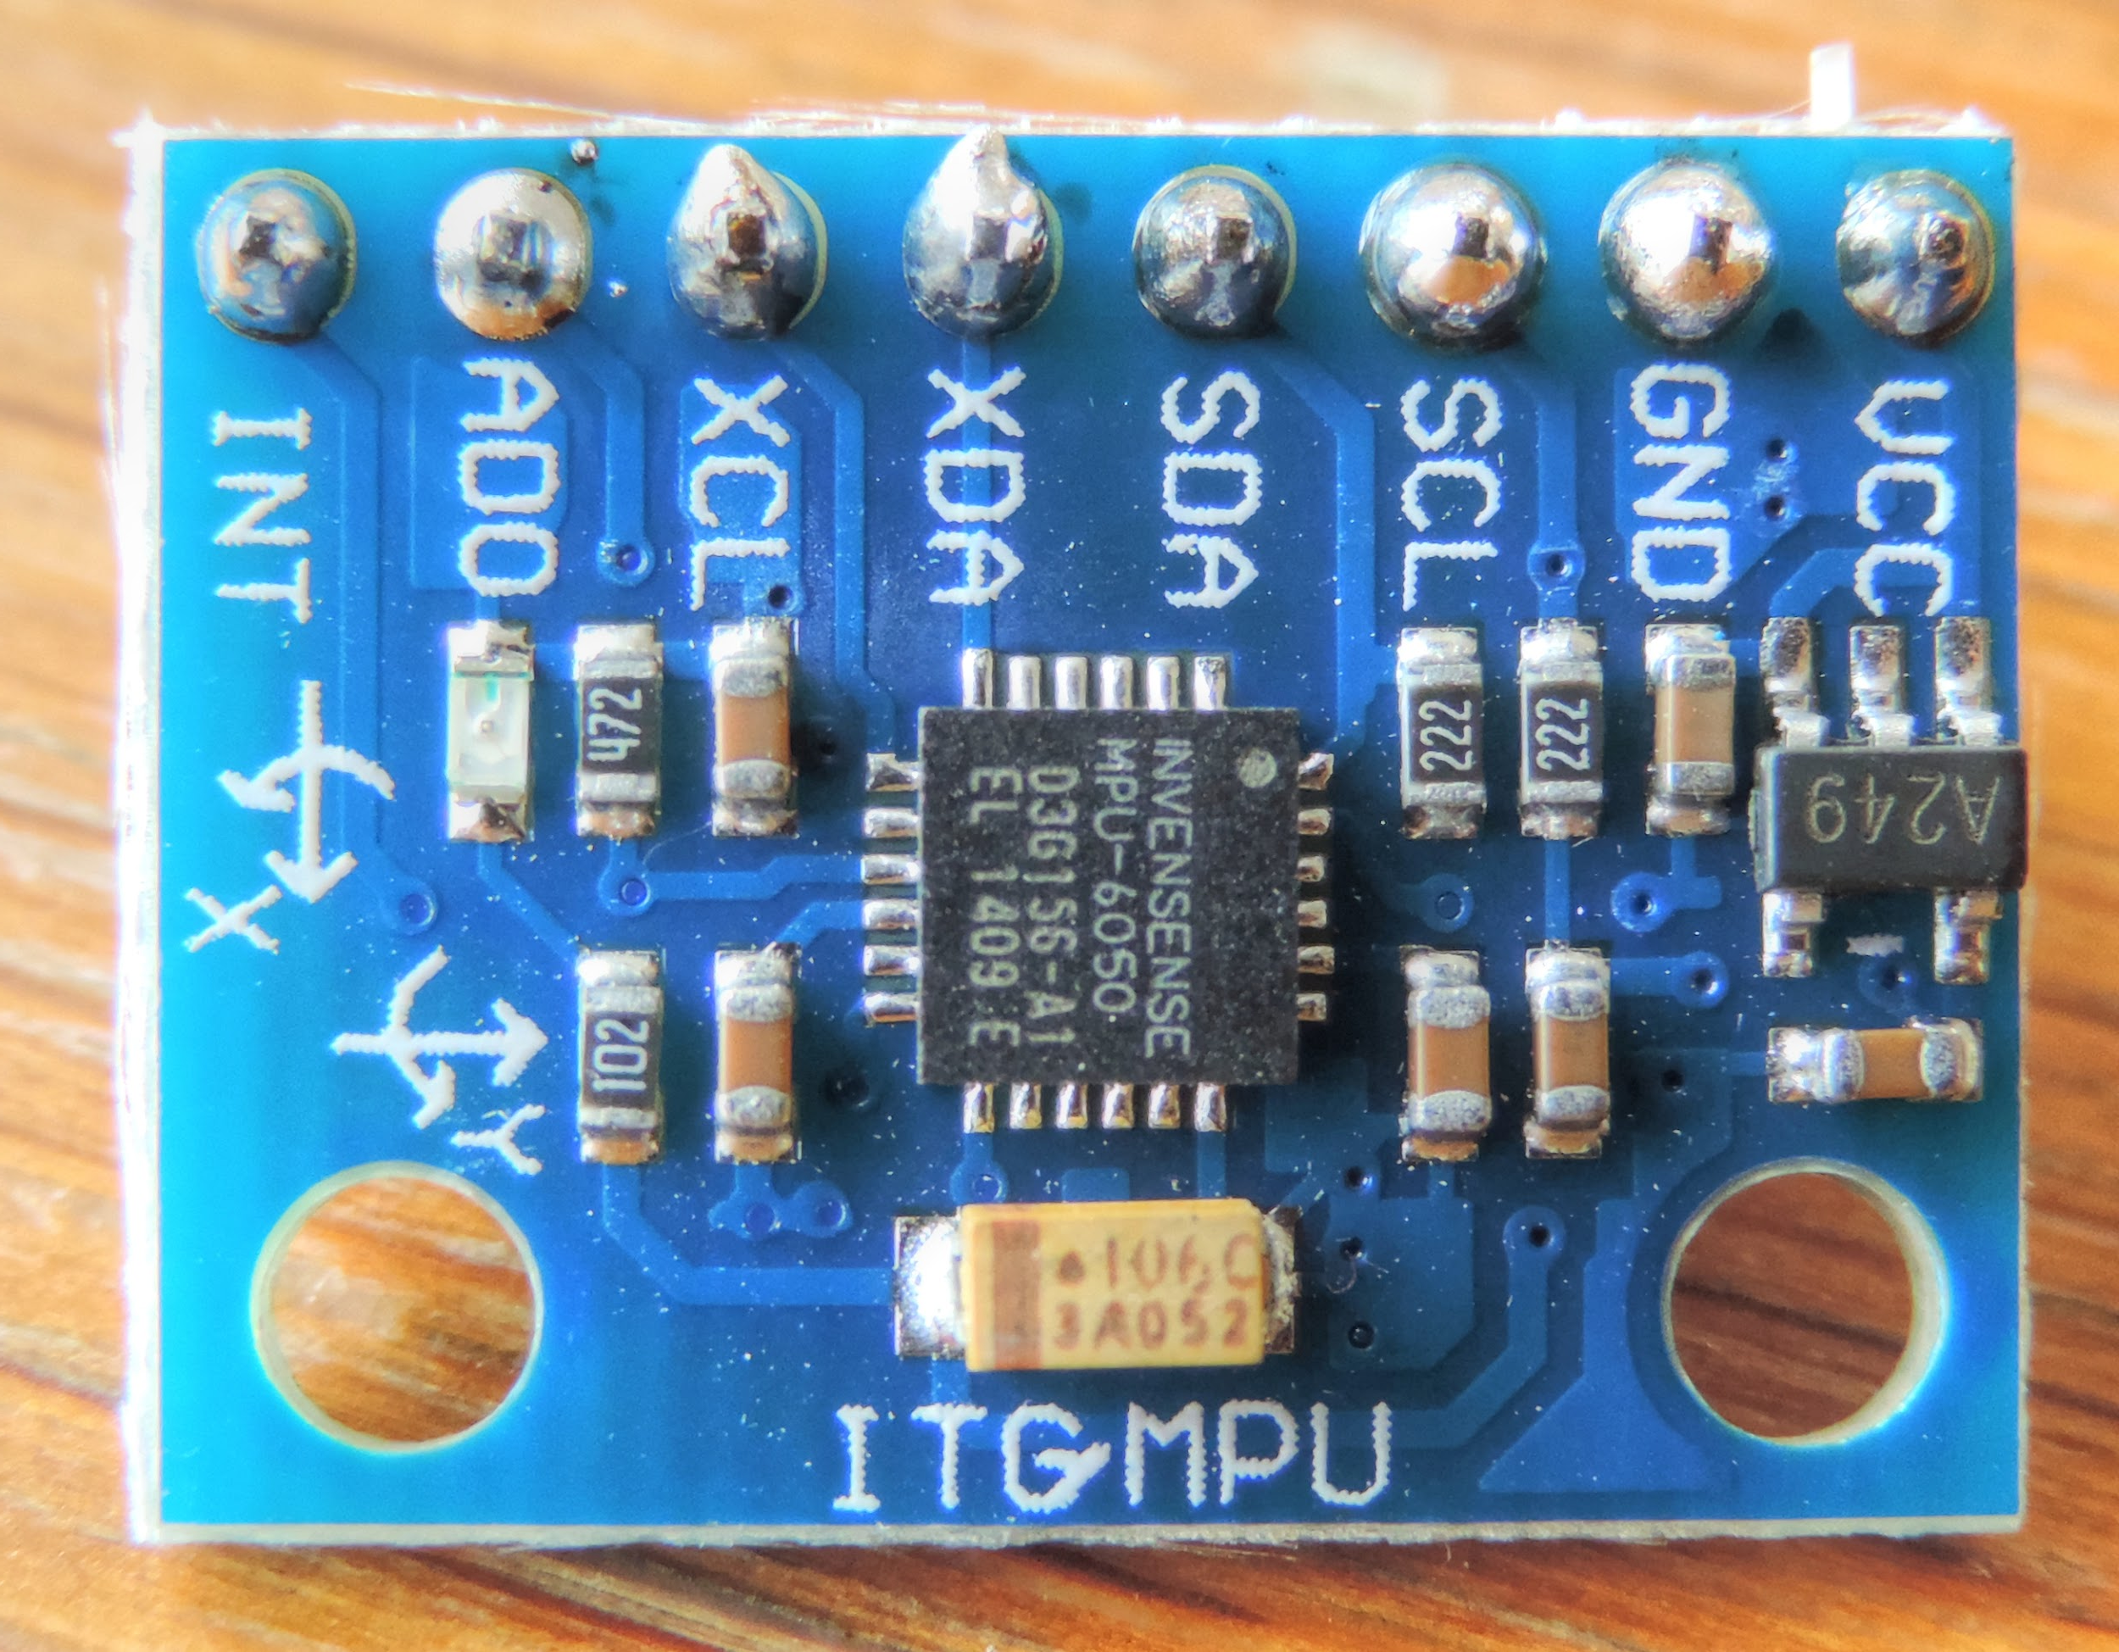
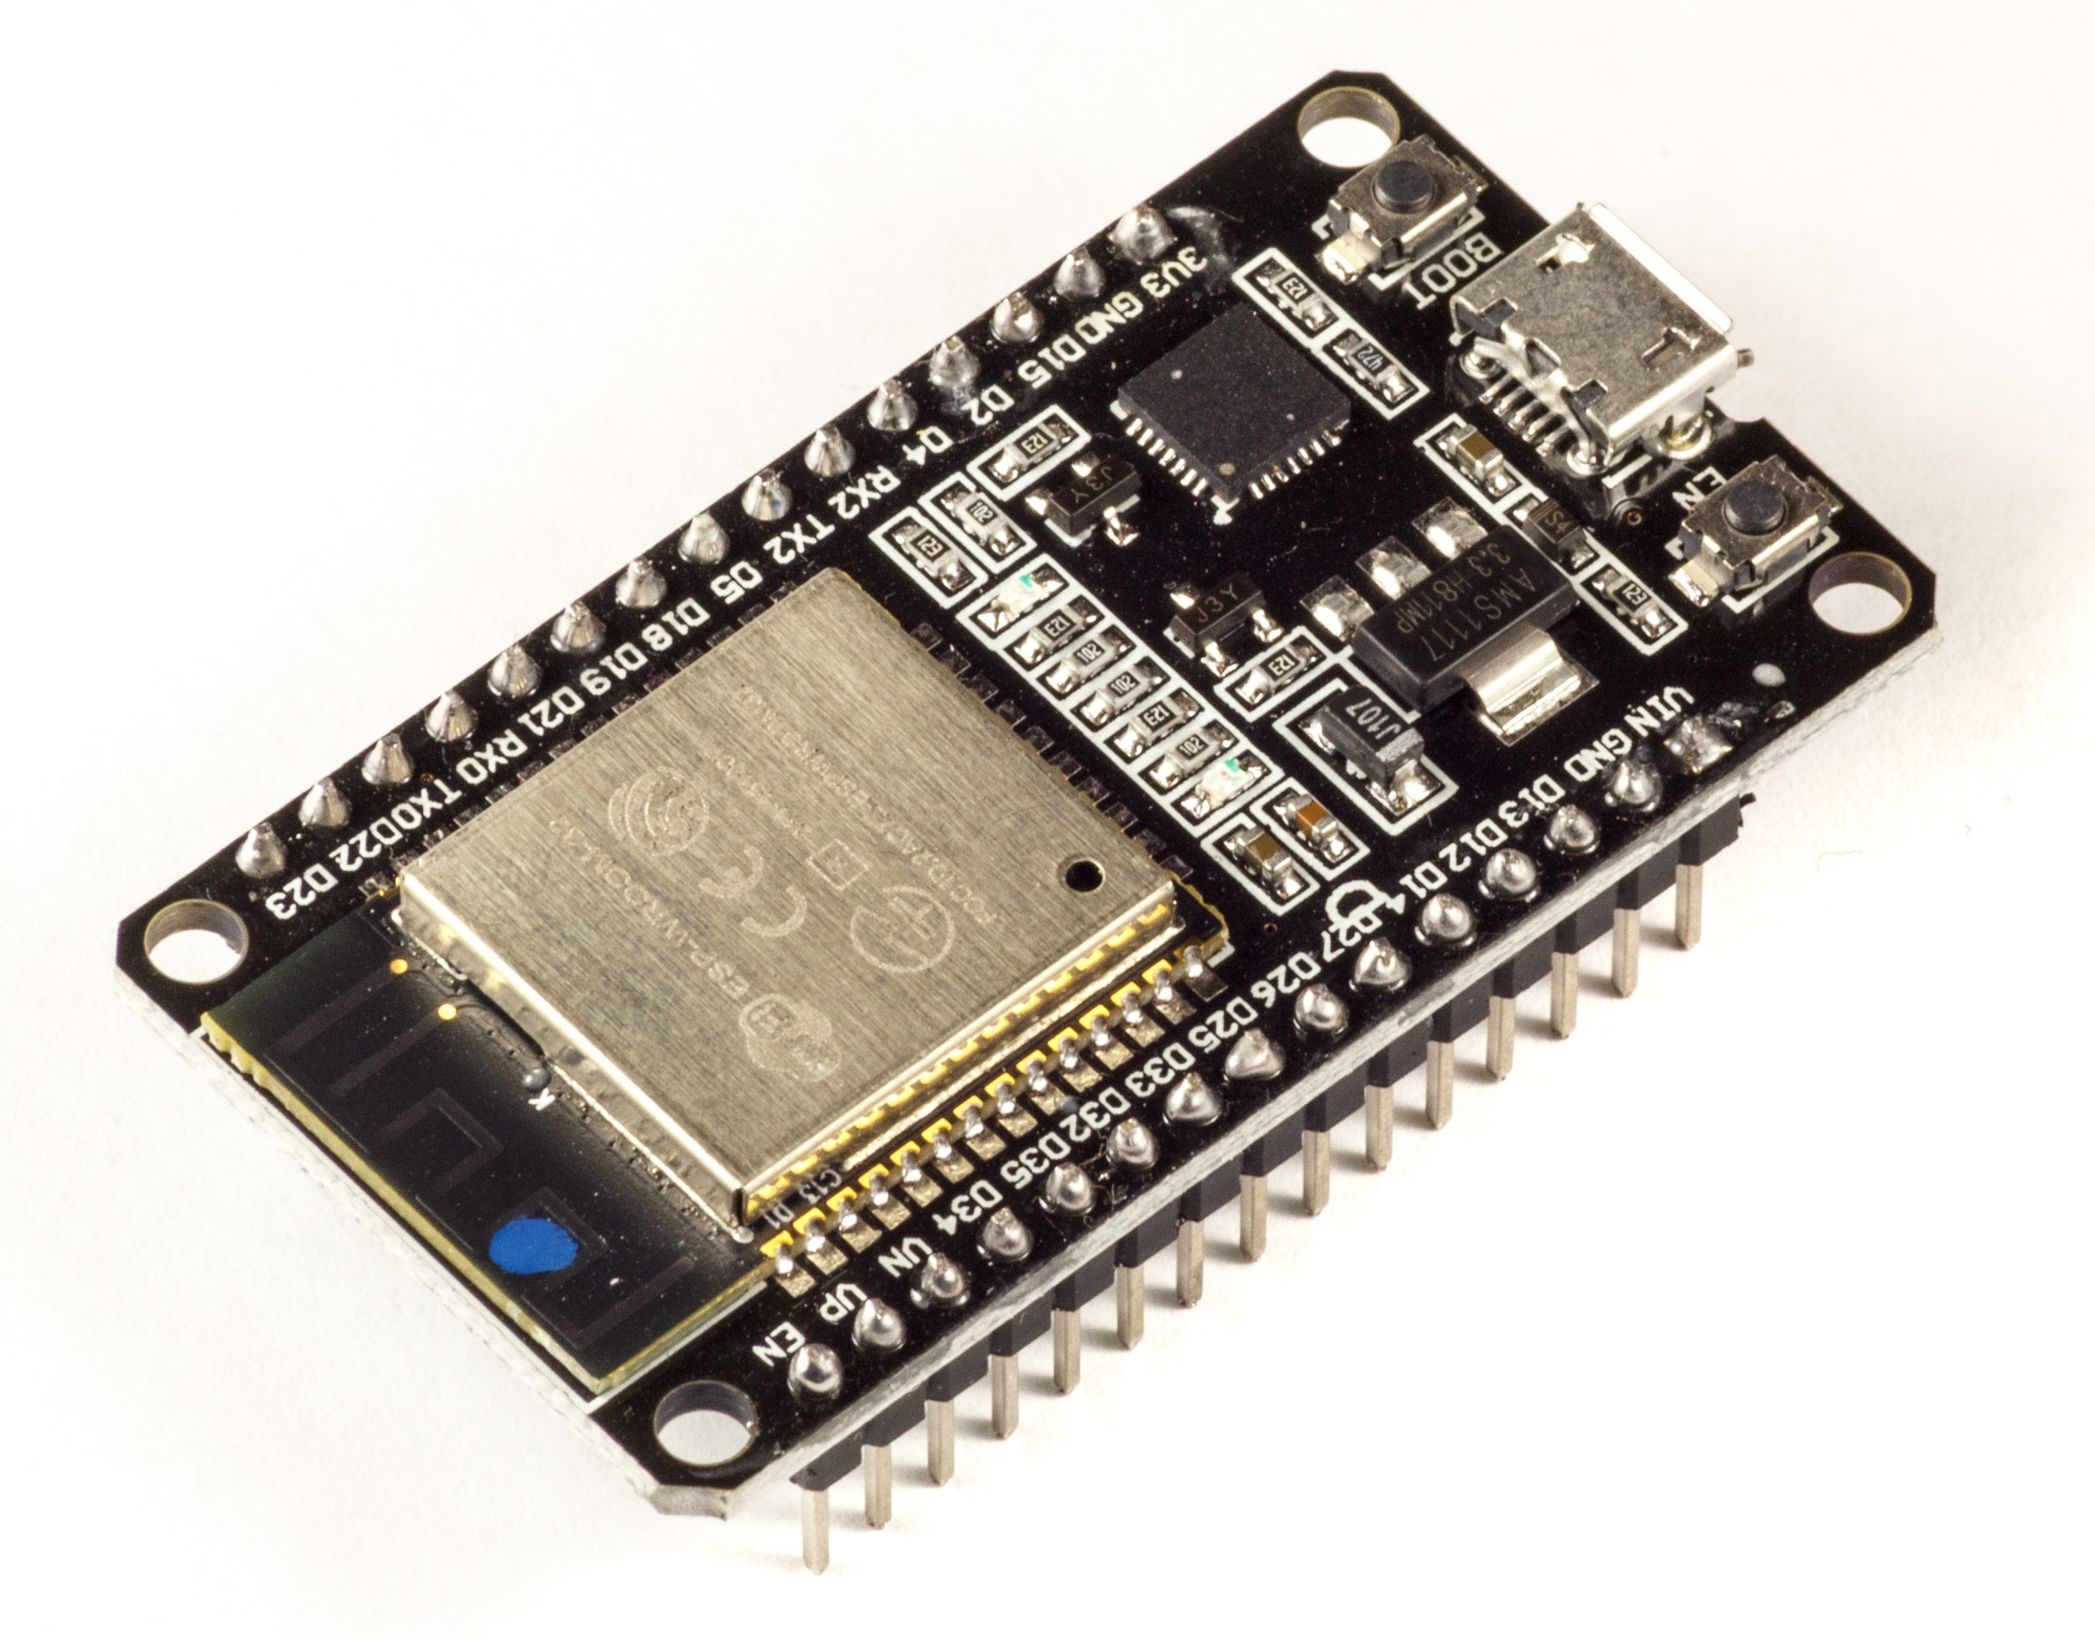
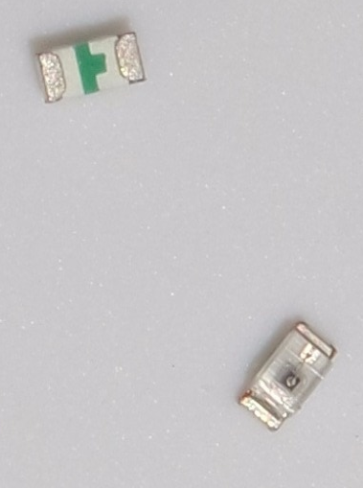
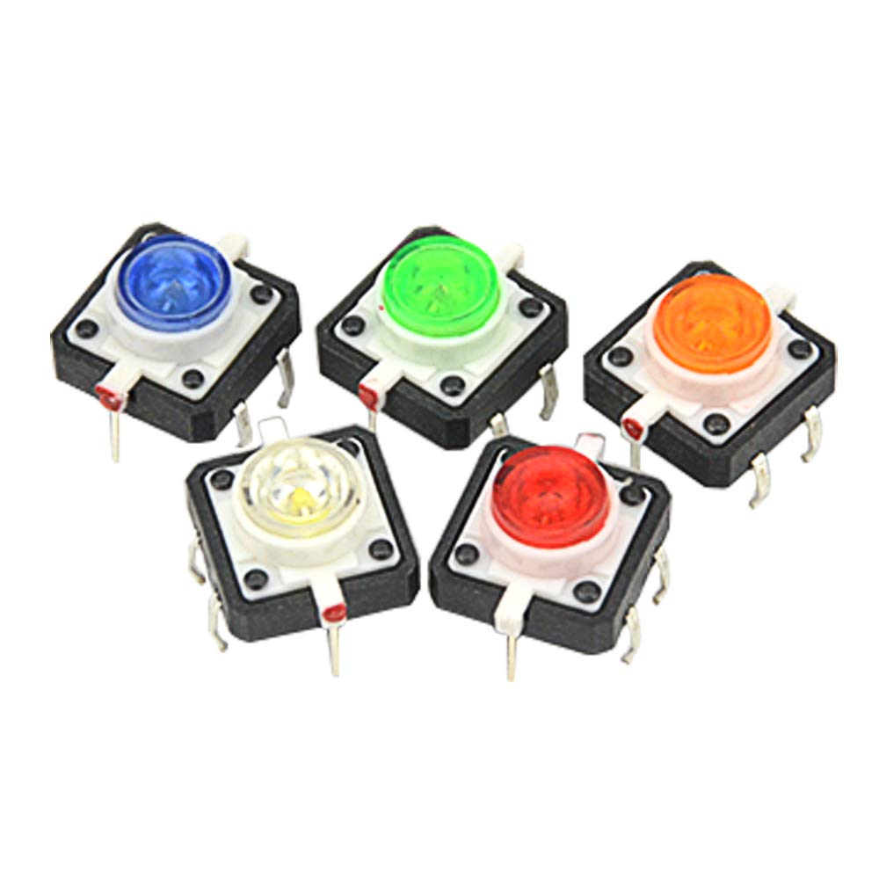
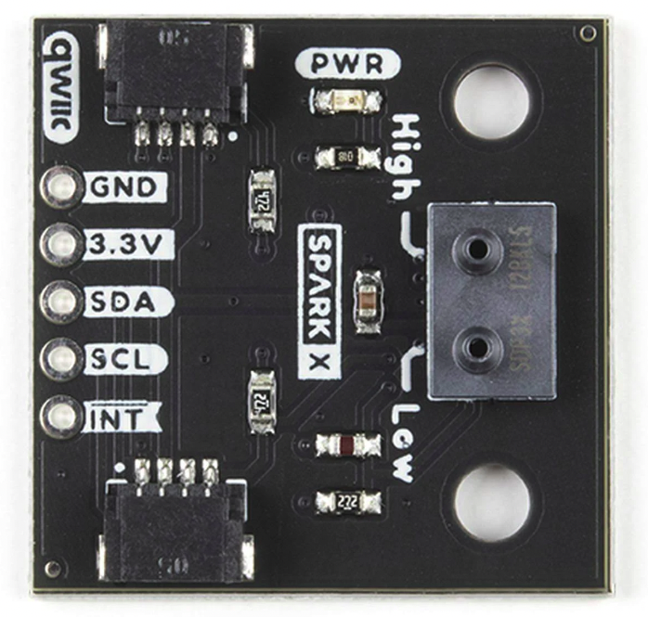
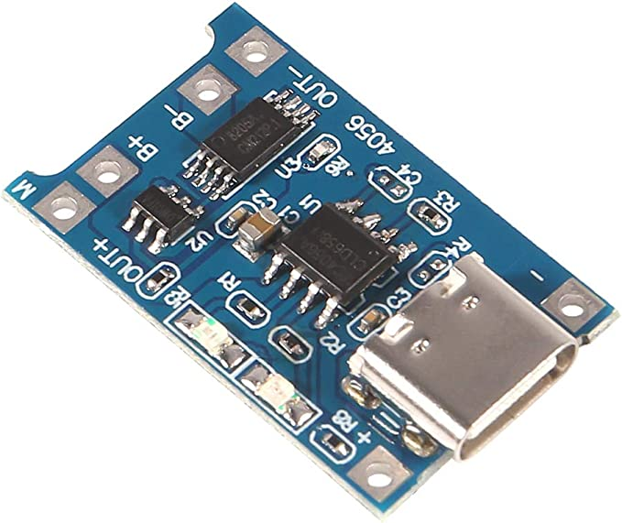
Version 1 Components

Slide 12
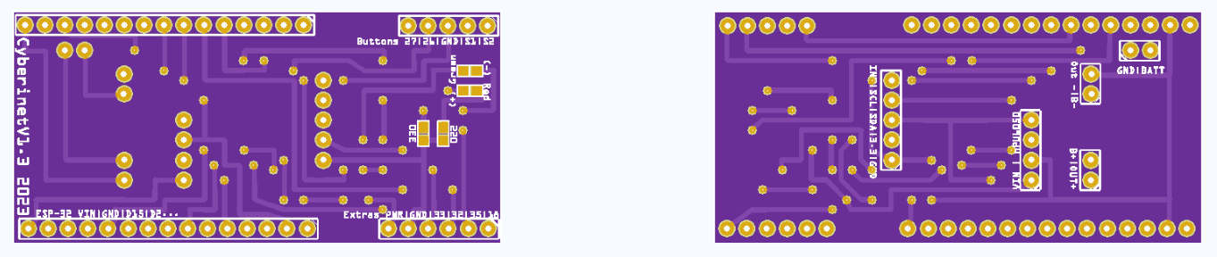
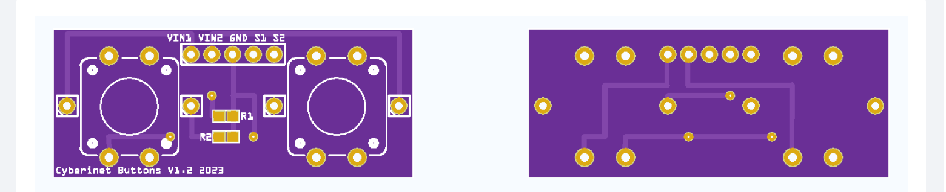
Main Board
Version 1 PCB Diagrams
Button Expansion

Slide 13
Optional add-ons
To further expand the functionality of the Cyberinet, multiple optional expansion units contain a variety of other sensors and can be utilized through the same expansion port. These include:
Microphone
Finger pressure sensors
Secondary movement sensor
Speaker
All of these are still in development, with the microphone closest to being functional.

Slide 14

Music

Slide 15
Puzzle of a Park (2023)
Written to utilize the optional button add-on.
Performer triggers the on-stage microphone & playback of recordings with a single button.
Functions similarly to a loop pedal.

Slide 16
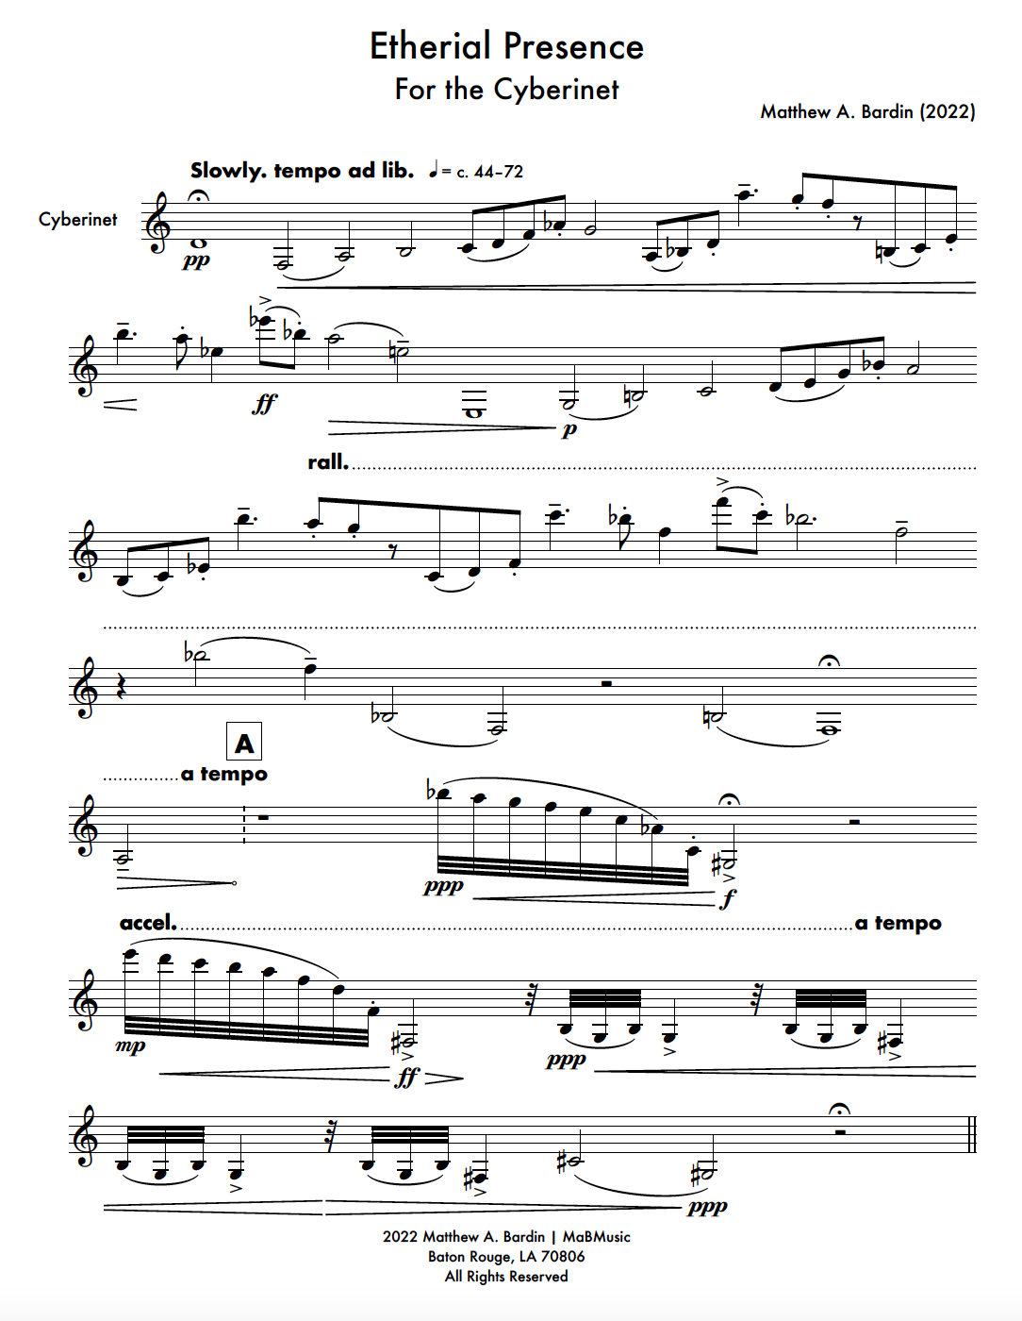
Ethereal Presence opening page

Slide 17
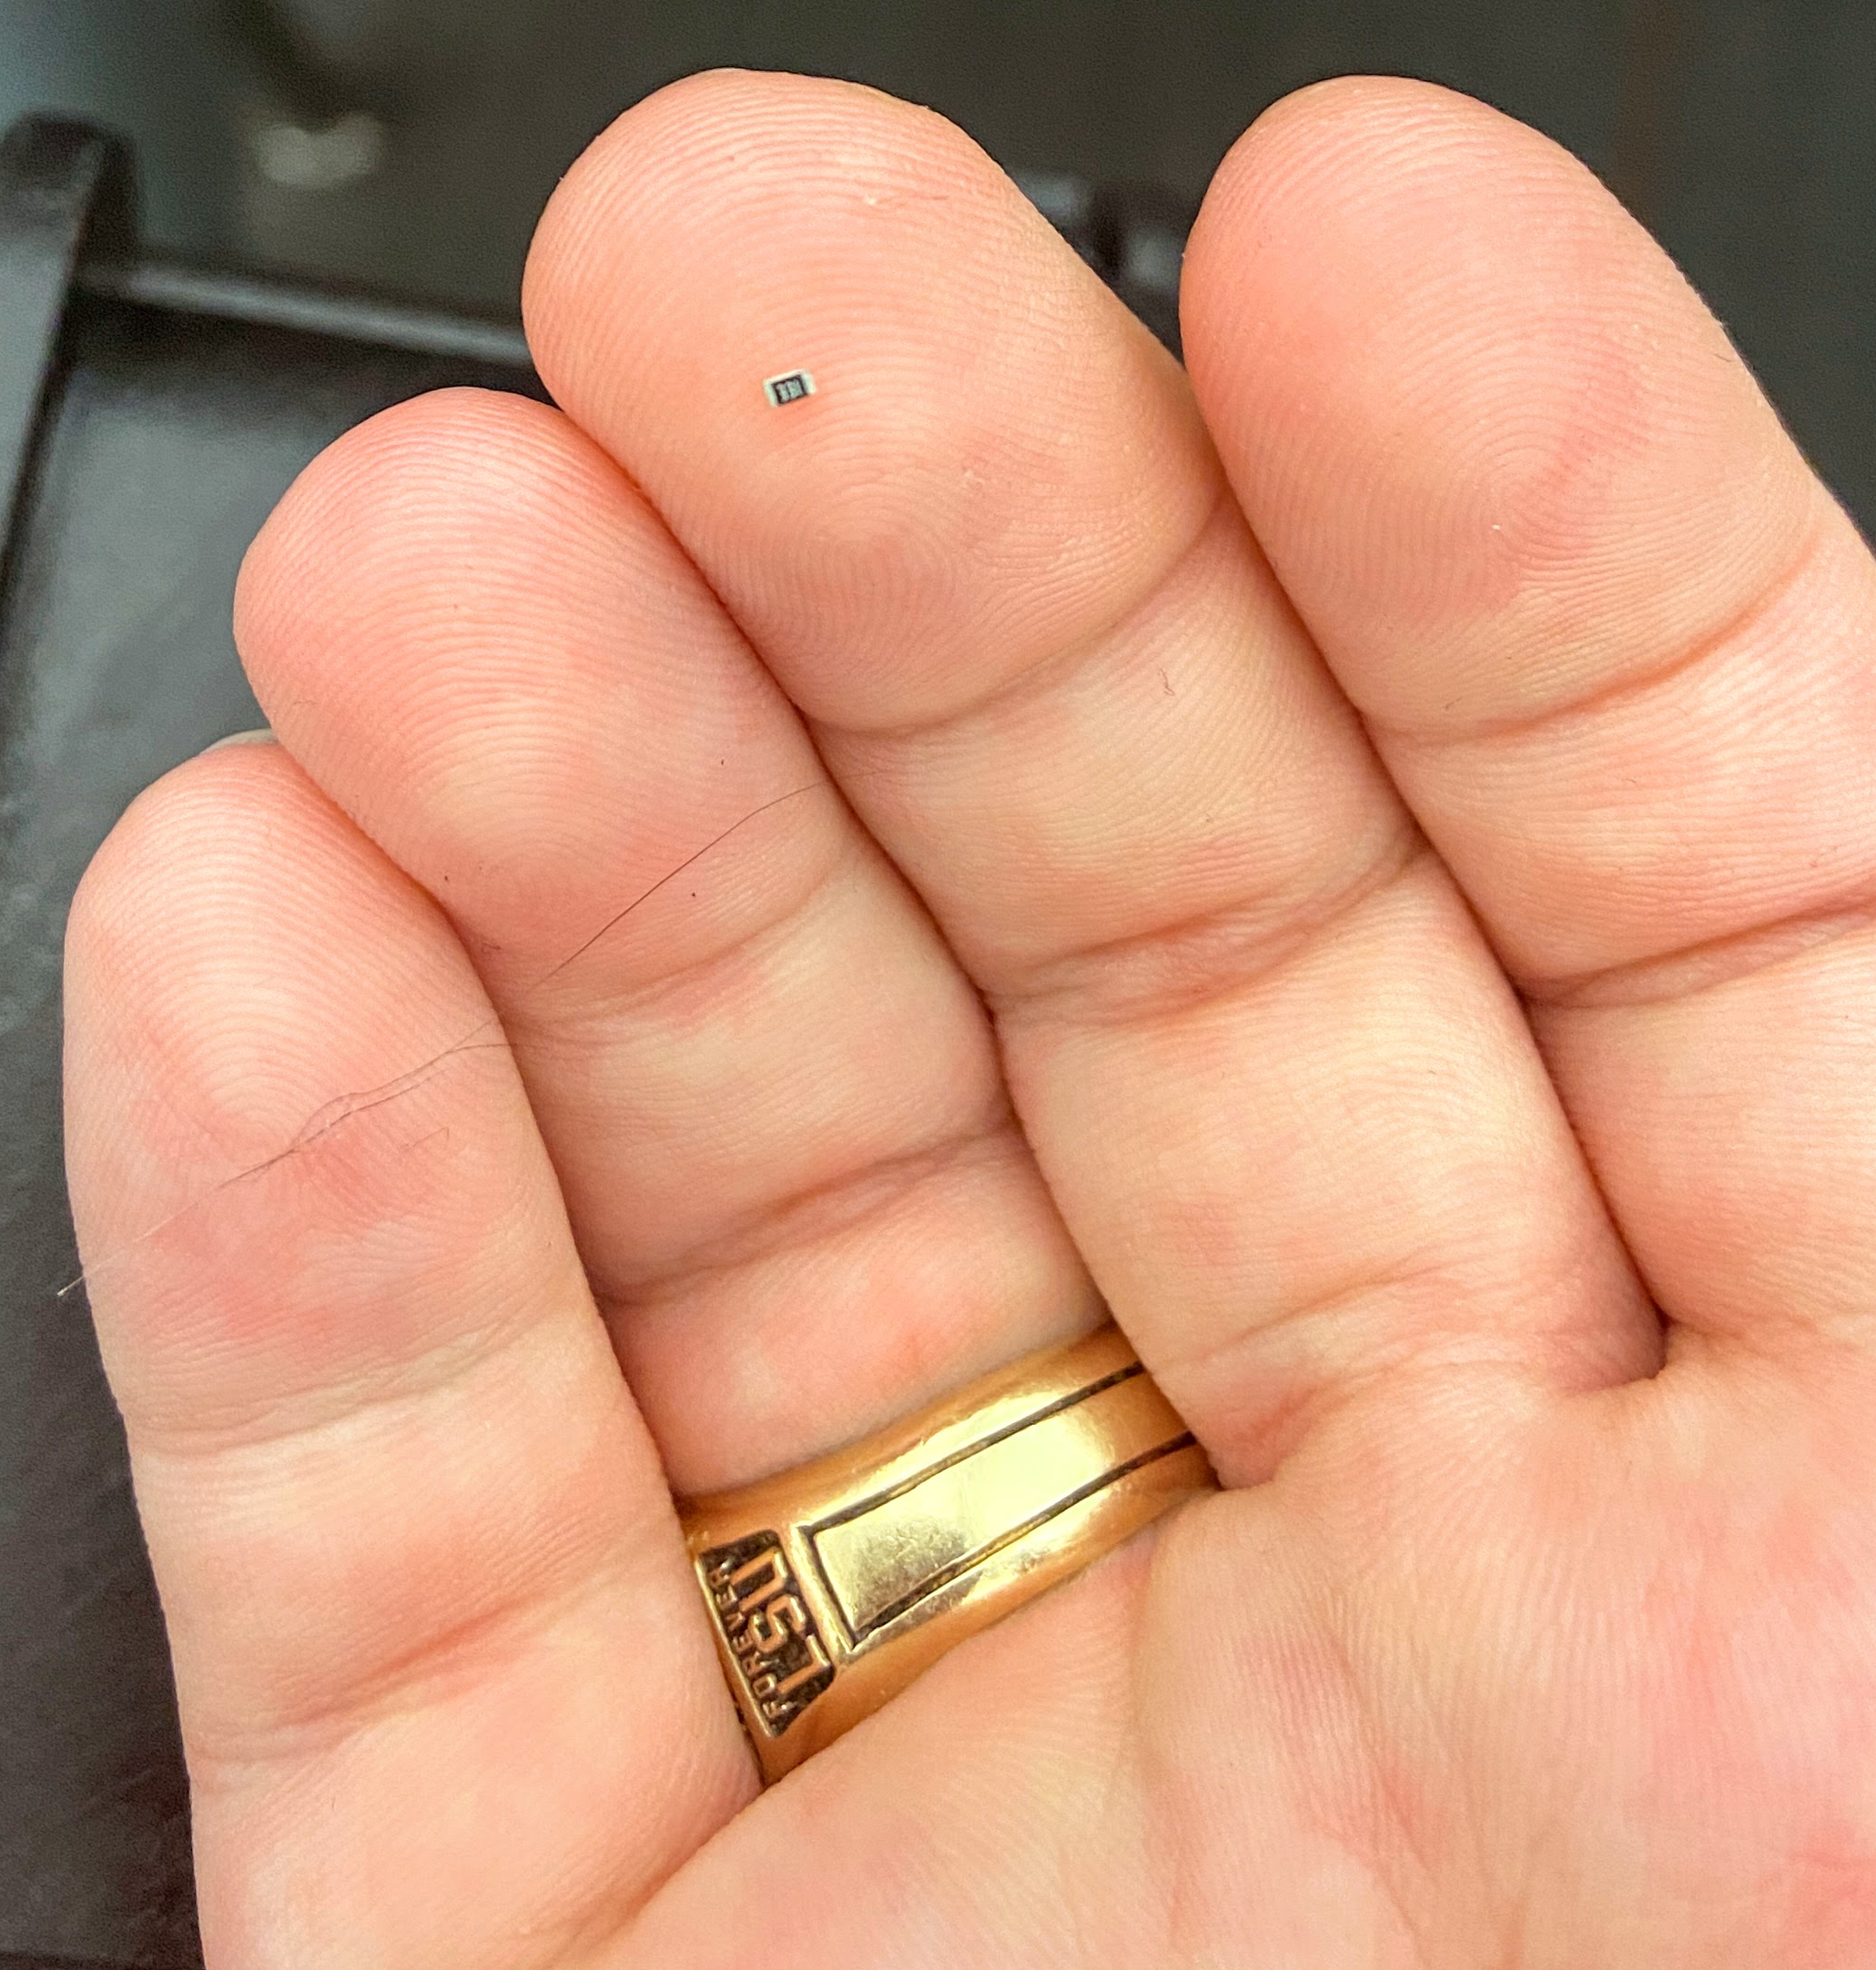
Assembling the Unit
Attach LEDs and Resistors (SMD Components)
Attach the USB-C and JST connectors to the main board. These are connected by ribbon cables and are supported by the outer case itself.
Solder the larger chips directly to the main PCB. This keeps the main unit as thin as possible. To allow for optimal alignment, the microcontroller And SDP chip should be elevated with pin headers.
Add a power switch in between the battery and the charging port. When done, connect the battery to the JST connector and insert everything into the main case. Glue as needed.

Slide 18
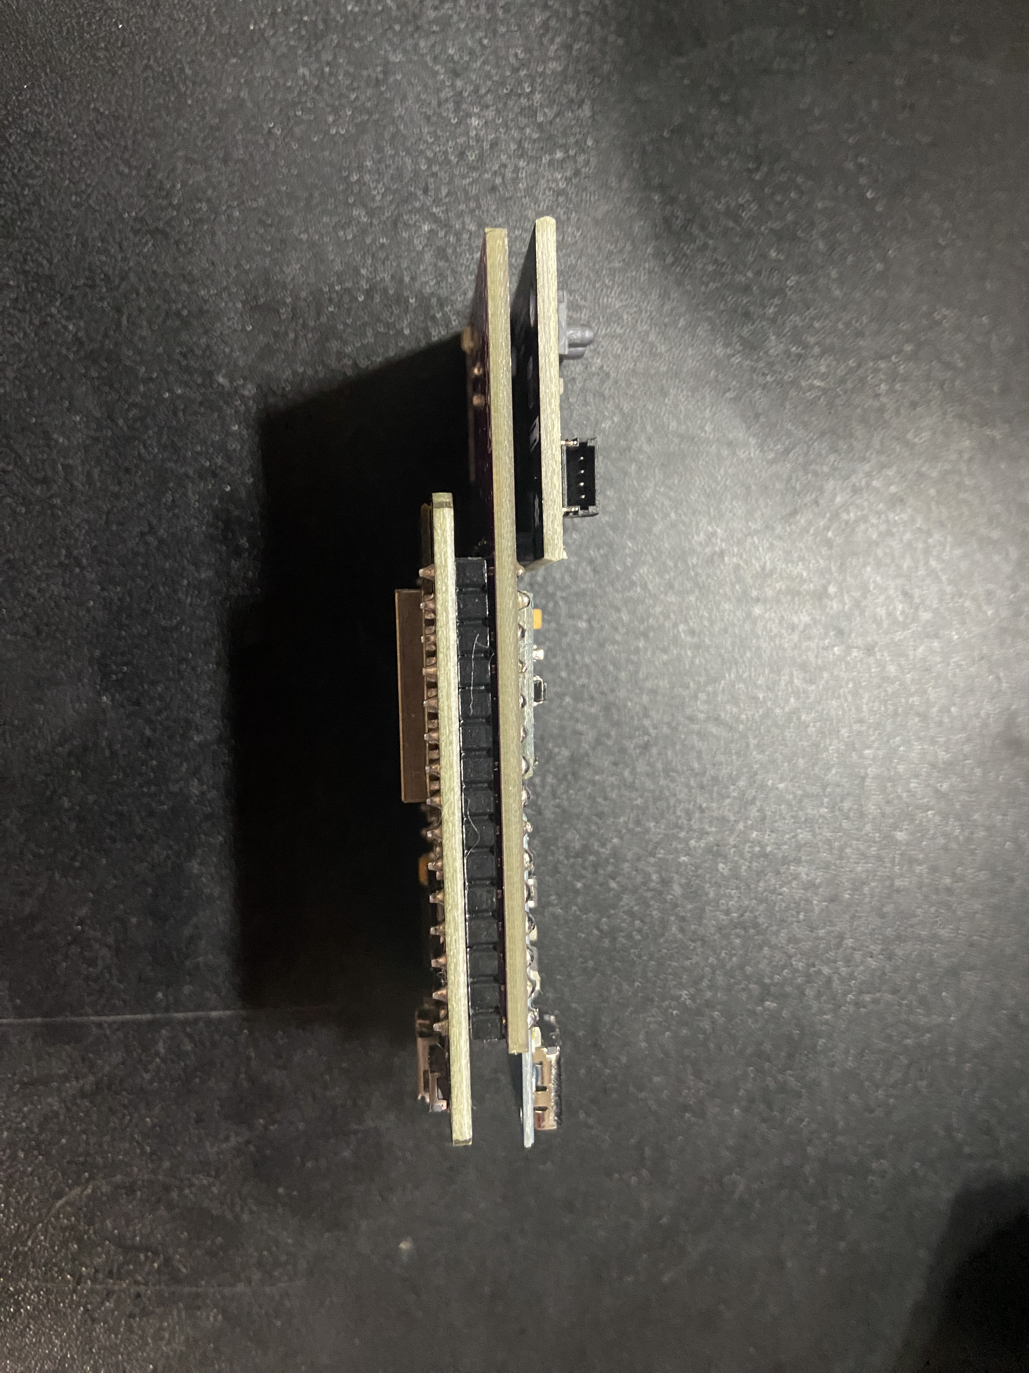
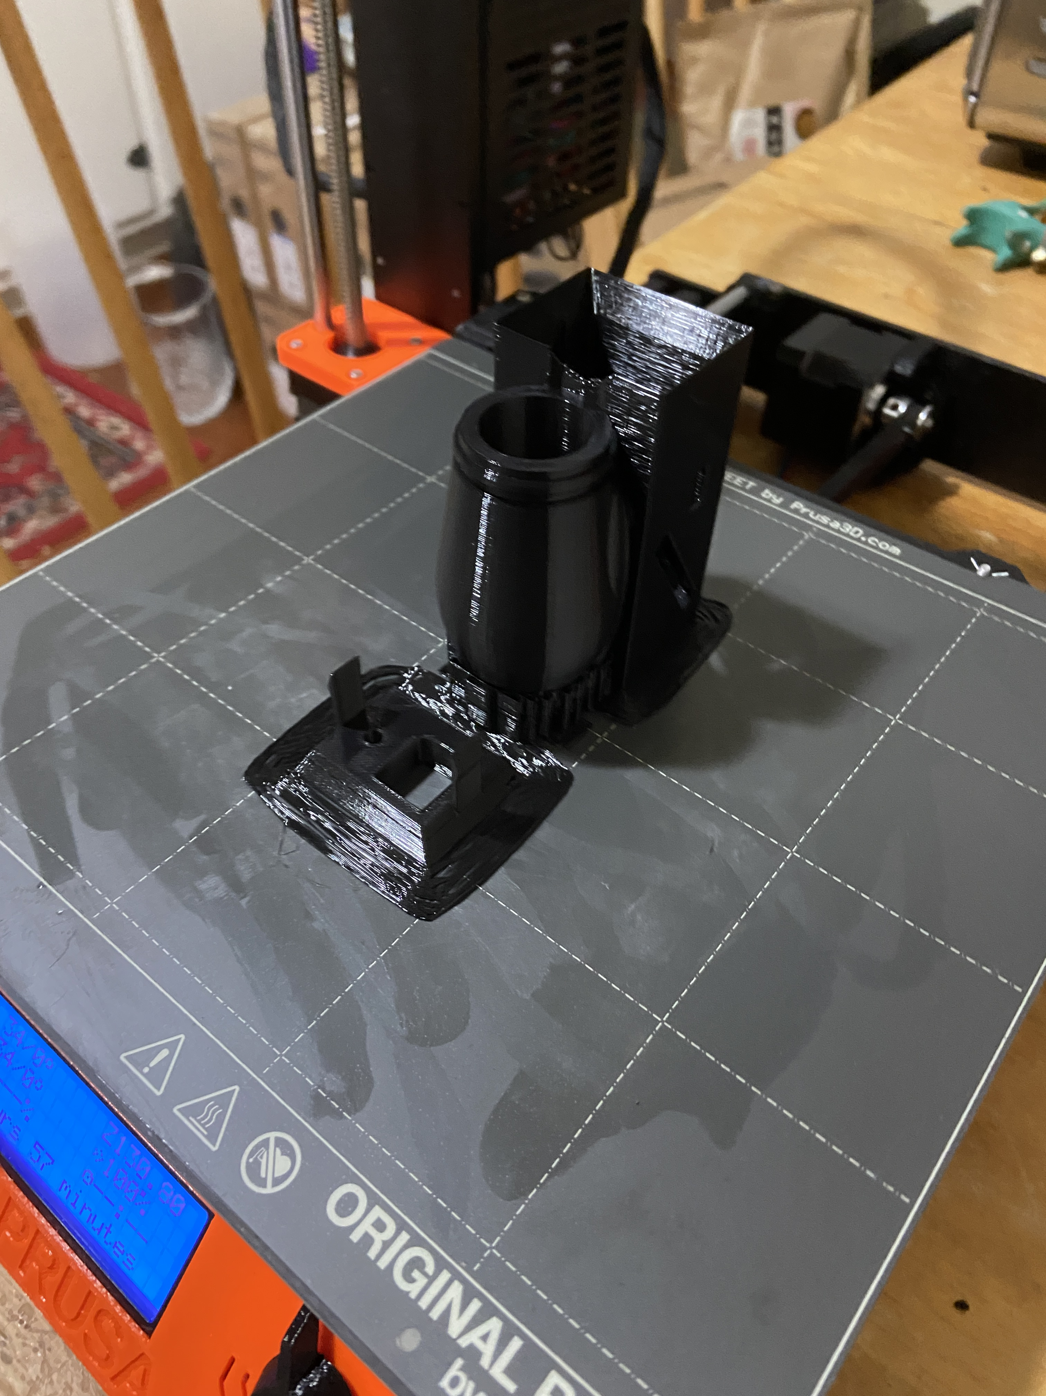
Version 1 with Button Board (with and without housing)

Slide 19

How it works

Slide 20
Collects data
The Cyberinet’s .ino code and attached sensors manage the collection of the performance data.
SDP31: Measures differential air pressure between the inside and outside of the instrument. Small tubes connect to the sensor to facilitate this. Also measures temperature.
MPU6050: Measures performer movement in 6 axis.
Buttons: triggerable by the performer

Slide 21
Transmits wirelessly
The main unit’s ESP-32 board the transmitting as well as the data collection.
By utilizing the Arduino library “BluetoothSerial” the DEVKIT can transmit serial communications through a Bluetooth connection. The device name is “CyberinetV1X” and currently requires no password to connect.
These values can be read by any serial terminal program on the host device. The Max objects utilize an additional node script to receive the data more reliably.

Slide 22
Music

Slide 23
Ethereal Presence (2022)
Utilizes gyroscope and airflow sensors
As the performer moves, the position of their instrument changes the pitch content of the accompaniment.
Computer synthesis has 2 main textures:
Filtered pink noise to provide backing texture
Modified FM synthesis to provide accompaniment to the soloist
Music alters between different styles to encourage a variety of performance movements.
Wide tempo variety helps encourage a non-identical performances.

Slide 24
Ethereal Presence opening page

Slide 25
processing/manipulation in Max
The main goal of the Cyberinet is to collect and transmit the sensor data.
From there it is largely up to the user to decide what they want to to with the data.
To help with that I have also created a series of Max patches that can be used to control various elements of a Max patch including:
Reverb
Delay
Gain
Band-Pass Filter
Playback Control
More coming
These are the Max patches I am using in the creation of a handful of music utilizing the Cyberinet in addition to other requested patches.

Slide 26
Max Patches Continued
The main 2 max patches included in the library are the two different receive patches.
The 2 patches work to receive and process the data coming in from the Cyberinet.
Cyberinet.Omnireceive is receiving, mapping, and outputting ALL of the sensor data at the same time.
Cyberinet.receive is technically receiving all of the data, but filters out all but one of the sensors and only outputs the selected output.

Slide 27

Sending to other programs
Data from the Cyberinet can be read by any software capable of receiving Serial data.
Simply connect the Cyberinet to the host computer and use the software’s ability to read serial data.
Another option is to send the data to Max as shown then transmit the data via OSC. This can be useful for processing data and sending it to other devices since the Cyberinet can only be connected to one host device at a time.

Slide 28
Online Resources

Slide 29
Github Repo
github.com/mbardin/Cyberinet
Contains code, diagrams, and other information

Slide 30
Code, Patches and Diagrams
All the resources are available on the GitHub repo.
If you would like to program your own unit, the base Arduino code and the necessary libraries are provided.
The Max patches used in my compositions as well as just the main receive patch is provided here as well. I am working to make a library that includes a lot of options for using the data.
Part lists, circuit diagrams, etc. are all available as well. I’m planning to sell these when complete, but if you want to make one yourself, I’ll have everything listed here. I’m unsure if I will offer it as a kit or not.

Slide 31
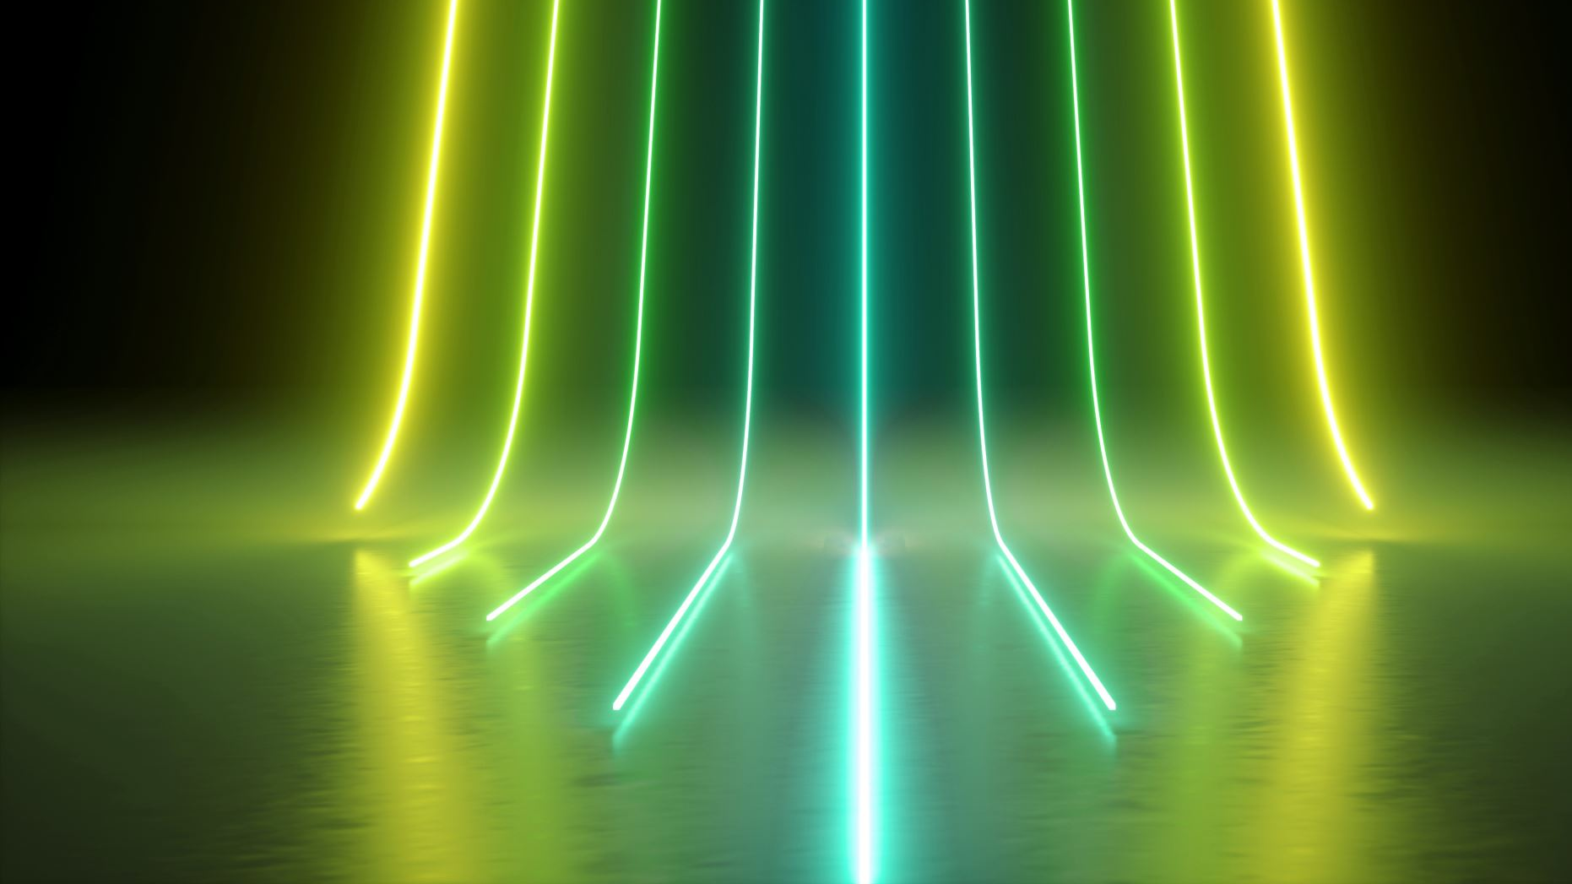
Future Directions

Slide 32
Future directions include
Optimal serial communications for Windows and Mac operating systems.
Permanent embedding within a clarinet?
Making versions for other instruments.
OSC Formatting for easier multi-platform use cases.
Password locking units to avoid miss-connections.

Slide 33
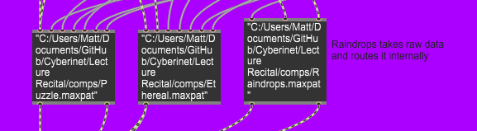
All the compositions are available in Max.
32
Each of the patches used to make these performances has been created as an object in Max. Performers can download these from the GitHub repo for performance, or experiment with their own processing.
Scores, patches and other info available at matthewbardin.com

Slide 34

Questions?

Slide 35
Music

Slide 36
Raindrops on a Tin Roof (2022-2023)
Utilizes all the included sensors:
Gyroscope/Accelerometer
Airflow
Buttons

Slide 37
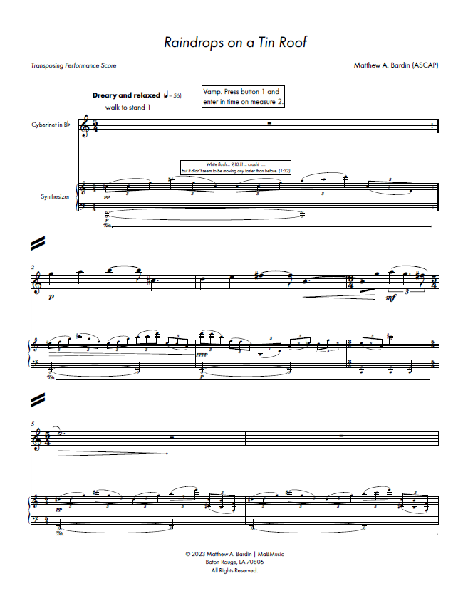
Raindrops on a Tin Roof opening page

